Slide 1

PAT REID MEMORIAL LECTURE
North-West University
Trends and Patterns in Disaster Reduction
Rowena Hay MSc
Potchefstroom, 2015 January 30

Slide 2
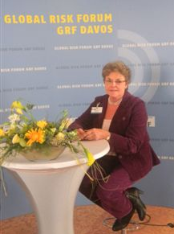
Acknowledgment of Pat Reid
Championed DMISA Bursary Programme, Formal qualification for disaster-management practitioners
Played key role in the formulation of Disaster Management Act – world-class example of DM legislation
Compiled several manuals and guidelines for local government, National Disaster Management Centre (NDMC), as well as Disaster Management plans for municipalities
Notes:
Source of photo:
http://www.disaster.co.za/index.php?id=57
She which she was so passionate about. She was a remarkable person and played a key role in the formulation of the Disaster Management Act - one of the world's best Disaster Management legislation. She also played a key role in developing a National Framework. She had exceptional knowledge of Disaster Management and compiled several manuals and guidelines for local government, the National Disaster Management Centre as well as Disaster Management Plans for municipalities.
Her courage and energy emerged out of a deep compassion for and a practical common sense understanding of the impact of disasters on ordinary people.

Slide 3
Outline
DRR road from Yokohama to Sendai
Perspective on the Sasakawa Prize for DRR
Perceptions on Global Risk: view from Davos (WEF)
UNEP Global Environmental Alert Service (GEAS) viewpoint
Resilience and Sustainability challenges

Slide 4
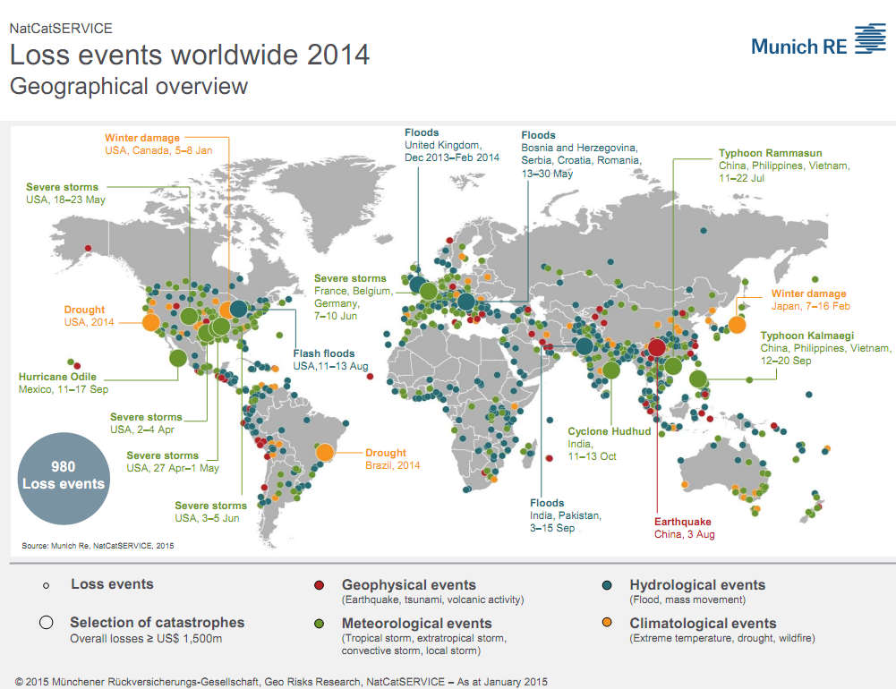
Notes:
This map shows the African landscape to be dominated by the risks posed by hydrometeorological events – floods and storms and significant droughts in the south and north east. The question is whether the cumulative losses arising from low impact disasters which affect the majority of the people are tallied in Africa. Are they the invisible statistic and to what extent is this recognised in the post HFA 2015. Can one measure how much poor governance impacts people whose resilience requires well functioning honourable government at local level?

Slide 5
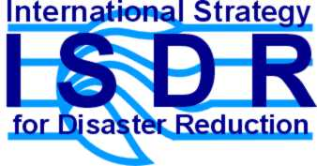
Global Trends- Disasters NOT natural
Natural and human-induced hazards
Climate change and variables
HAZARDS +
EXTREME EVENTS
Socio-economic: poverty,
unplanned urban growth, lack of awareness and institutional capacities...
Physical: insufficient land use planning, housing, infrastructures located in hazard prone areas...
Environmental degradation
oil spills; coastal, watershed, forest, wetland degradation...
VULNERABILITY
Anatomy of “natural” disasters
Natural hazard
x
Vulnerability
=
Disaster Risk
Notes:
The Hyogo Framework took a big step forward- does not talk about “natural disasters” but ays in footnote 3:
The scope of this Framework for Action encompasses disasters caused by hazards of natural origin and related environmental and technological hazards and risks. It thus reflects a holistic and multihazard approach to disaster risk management and the relationship, between them which can have a significant impact on social, economic, cultural and environmental systems, as stressed in the Yokohama Strategy

Slide 6
Disaster Reduction – Agenda to WCDR-2
1989: IDNDR 1990-1999 – promotion of disaster reduction, technical and scientific buy-in
1994: Yokohama Strategy and Plan of Action –first blueprint for disaster reduction policy guidance (social & community orientation)
2000: International Strategy for Disaster Reduction (ISDR) - increased public commitment and linkage to sustainable development, enlarged networking and partnerships. Mechanisms: IATF/DR, ISDR secretariat, UN Trust Fund
2002: Johannesburg Plan of Implementation- WSSD Includes new section on “An integrated, multi-hazard, inclusive approach to address vulnerability, risk assessment and disaster management…”
2005: WCDR - Hyogo Framework for Action 2005-2015 Building Resilience of Nations and Communities to Disasters
Notes:
Evolution of Disaster Risk Reduction Agenda
- Arriving to the World Conference on Disaster Risk Reduction and the Adoption of the Hyogo Framework for Action (HFA)

Slide 7
Hyogo Framework of Action 1995-2015
Yokohama Strategy + World Conference Disaster Reduction =
Ensure that disaster risk reduction is a national and a local priority with a strong institutional basis for implementation.
Identify, assess and monitor disaster risks and enhance early warning.
Use knowledge, innovation and education to build a culture of safety and resilience at all levels.
Reduce the underlying risk factors.
Strengthen disaster preparedness for effective response at all levels.
Notes:
The Hyogo Framework of Action is a remarkably common sense document which emerged out of a small community of scientists and disaster management practitioners and was catapulted into global view at the WCDR in 2005 possibly because of the December 26th 2004 Tsunami.
1989: IDNDR 1990-1999 – promotion of disaster reduction, technical and scientific buy-in
1994: Yokohama Strategy and Plan of Action –first blueprint for disaster reduction policy guidance (social & community orientation)
2000: International Strategy for Disaster Reduction (ISDR) - increased public commitment and linkage to sustainable development, enlarged networking and partnerships. Mechanisms: IATF/DR, ISDR secretariat, UN Trust Fund
2002: Johannesburg Plan of Implementation- WSSD Includes a new section on “An integrated, multi-hazard, inclusive approach to address vulnerability, risk assessment and disaster management…”
2005: WCDR - Hyogo Framework for Action 2005-2015 Building the Resilience of Nations and Communities to Disasters

Slide 8
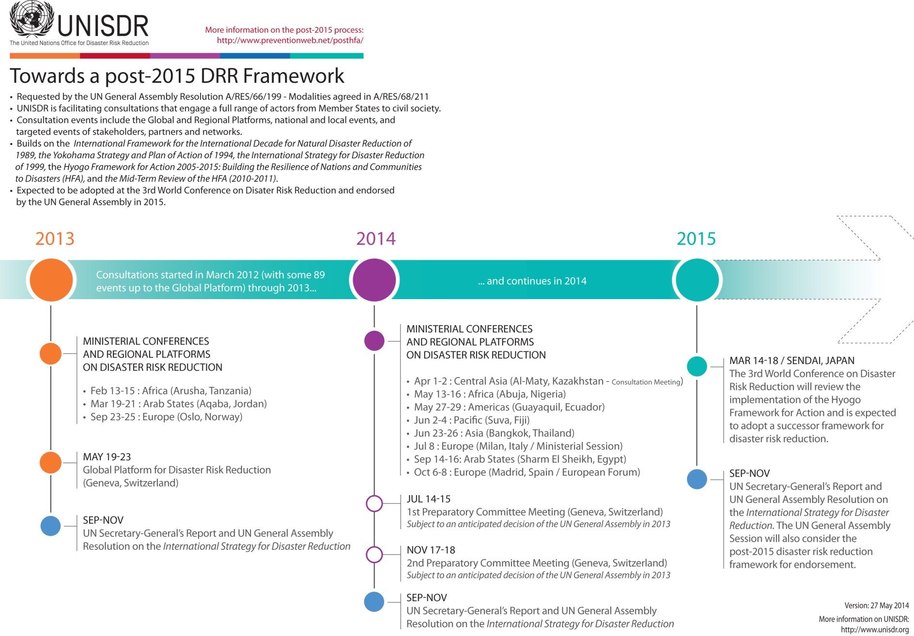
Post-2015 DRR Framework
Notes:
Source:
https://www.flickr.com/photos/isdr/14259154486
@ Chris Plse add animation

Slide 9
Post-2015 Priorities for Action
Experience gained through implementation of the HFA indicates need for “… focussed action across sectors by States at local national, regional and global levels in …”:
  Understanding disaster risk
  Strengthening governance and institutions to manage disaster risk
  Investing in economic, social, cultural and environmental resilience
  Enhancing preparedness for effective response, and building back better in recovery and response

Slide 10
Post-2015 goals
“It is time for the world to embed resilience to disasters into the industrialization process and the development of towns and cities, accounting for factors like seismic threats, flood plains, coastal erosion, and environmental degradation. If the UN conference produces the right agreement, resilience can become the hallmark of 2015, setting the tone for agreements later in the year on climate change and sustainable development – both of which hold important implications for disaster risk” (Margareta Wahlström, UN-ISDR)
Notes:
Quote from: http://www.unisdr.org/archive/42023
“Many views and several options have been expressed including a more nuanced version of the existing HFA, some overall guiding principles, a set of common standards, a framework with targets, a legally-based instrument for disaster risk reduction, or a combination of these. At the same time, disaster risk and resilience received insufficient emphasis in the original Millennium Development Goals (MDGs) agenda. In the Outcome document of Rio+20 "The Future We Want" member states highlighted the need to address disaster risk reduction and climate change adaptation in setting the Sustainable Development Goals” http://www.unisdr.org/we/coordinate/hfa-post2015
There can be challenges ahead – there are 17 Sustainable Development Goals – mention a few…….
200 Indicators have been proposed to monitor how and who makes what progress towards realising these goals
The UNEP – who being modern day environmentalists and more systems understanding driven – have wo success – proposed nested indicators that reflect the financial, social and environmental elements of development – mention TWIGG approach?
Can we in Southern Africa consider picking up on the UNEP approach – approach the regional office in Kenya for assistance maybe in piloting a set of indicators that is more realisable to measure and possibly better reflect the nested vulnerability elements on the ground – in this I am also reminded of Pat – she was not sentimental nor was she a follower – her approach was informed by experience, knowledge and common sense. The post HFA 2015 specifically states …support to Africa re what it needs …..let us in Southern Africa – through a DMISA special project maybe, work out what we can do – reliably and responsibly, map where we would like to go and what we need to measure to get there.
With this in mind I present a summary overview of the World Economic Forum and ? Reflecting the relationship between economy, governance, environment and ordinary people…..

Slide 11
Outline
DRR road from Yokohama to Sendai
Perspective on the Sasakawa Prize for DRR
Perceptions on Global Risk: view from Davos (WEF)
UNEP Global Environmental Alert Service (GEAS) viewpoint
Resilience and Sustainability challenges

Slide 12
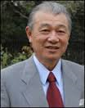
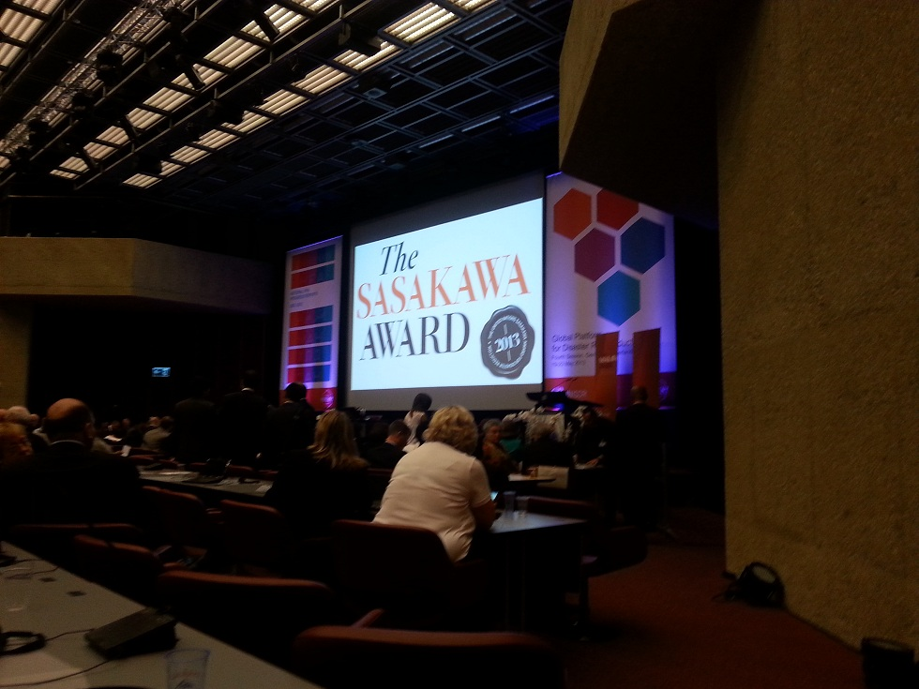
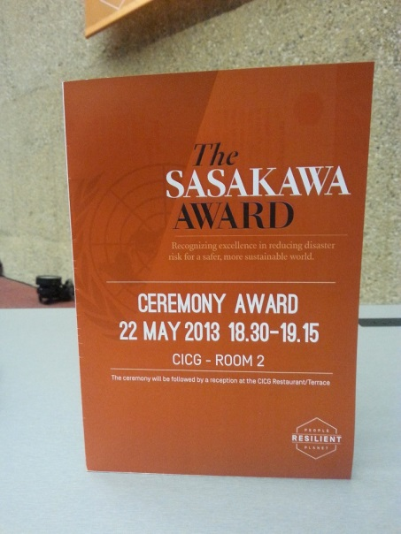
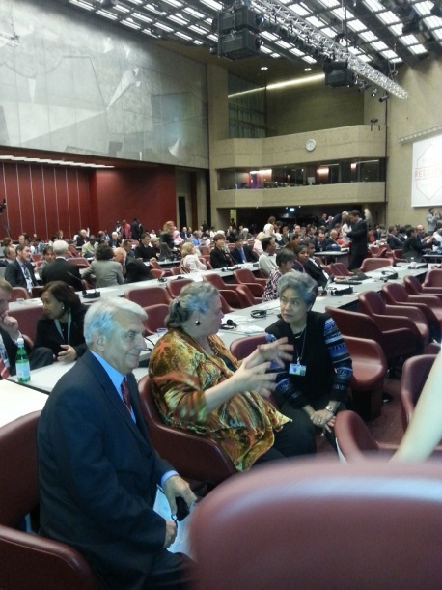
Sasakawa Award perspectives
Donated by Yohei Sasakawa, Chairman of Nippon Foundation
Jurors represent each of the five regions
  Asia, Pacific, Americas, Europe, Africa
Annual Award 1995 – 2005
Biennial since 2005
Presented at the GPDR/WCDR since 2009
Increase in nominations since 2011
Notes:
The UNISDR coordinates a jury who selects the winner of the Sasakawa Award for Disaster Risk Reduction. Since 1995 there have been five (some years four) jurors, one selected from each region (Africa, SE Asia, The Americas, Europe and the Pacific region). There are other Sasakawa awards e.g for excellence in Environmental work which is coordinated by UNEP. (Check these facts). It is a relatively small prize in monetary value ($50 000) but has prestige and illustrates global recognition for work in Disaster Risk Reduction. Possibly DMISA can consider raising funds for an award for excellence in DRR in Southern Africa - in honour of Pat Reid, the winner of which would become a nominee by the DRR community for the Sasakawa award.

Slide 13
UNISDR Sasakawa Awards
2002: Professor Dr. Serguei Balassanian, President, Armenian Association of Seismology and Physics of the Earth's Interior (AASPEI), Armenia
2003: Mrs. Tadzong, née Esther Anwi Mofor, Provincial Chief of Service for Planning and Guidance, Ministry of National Education, Cameroon
2004: Dr. Omar Dario Cardona, Colombia
2005: Mr. Chimeddorj Batchulluun, National Emergency Management Agency (NEMA), Mongolia
Notes:
1. See document I compiled “Sasakawa award trends”
2. “Sharing of responsibilities in decisions of risk reduction has been particularly emphasized by the new international policy. UNISDR in its principles related to ‘resilient cities’, in its ‘ten essentials’, and by its provision of a special guide for establishing and running participatory methods has indicated the priority that must be given to collaboration in DRR” (Rowena).
3. “There are several theoretical benefits of decentralization that could help to resolve some of the political incentive problems identified in this report. These include the possibility of more active citizen participation in local DRR policies and programmes, the potential for stronger public accountability in local settings where decision-makers and service providers are closer and more accessible to the populations they serve, and the stronger alignment of interests between local politicians and citizens who are exposed to the same disaster risks” (Global Assessment Report 2011 by Gareth Williams) .

Slide 14
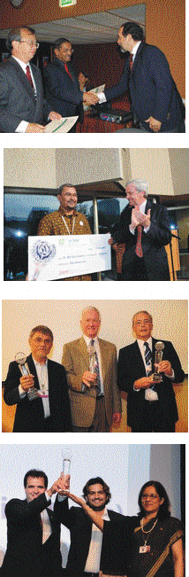
UNISDR Sasakawa Awards
2007: Professor Yoshiaki Kawata, Japan and Tony Gibbs, Caribbean engineer in building safety
2009: Dr. Eko Teguh Paripurno, Indonesia
2011: Cities of San Francisco (Philippines), Santa Fe (Argentina), and the District of North Vancouver (Canada)
2013: Belo Horizonte (Brazil) and National Alliance for Risk Reduction and Response Initiative (Bangladesh)

Slide 15
Trends in Sasakawa awards
Acknowledge scientific contributions of individuals
Recognize projects with significant community impact
Collaborative approaches (Govt/NGOs/-Communities/- Private sector)
What was considered as hallmark of excellence?
1994 - 2009
2009 – 2011
2011 - 2013
Notes:
Sciemce 1995 – 2004
2005/7 community
Collaborative approach 2011
2015?

Slide 16
Outline
DRR road from Yokohama to Sendai
Perspective on the Sasakawa Prize for DRR
Perceptions on Global Risk: view from Davos (WEF)
UNEP Global Environmental Alert Service (GEAS) viewpoint
Resilience and Sustainability challenges

Slide 17
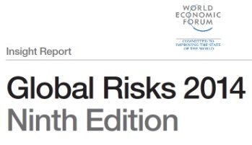
World Economic Forum perspectives
Commissioned for global elites convening annually in Davos, Switzerland
Published by WEF in collaboration with:
  Marsh & McLennan Companies
  Swiss Re
  Zurich Insurance Group
  National University of Singapore
  Oxford Martin School, University of Oxford
  Wharton Risk Management and Decision Processes Center, University of Pennsylvania

Slide 18
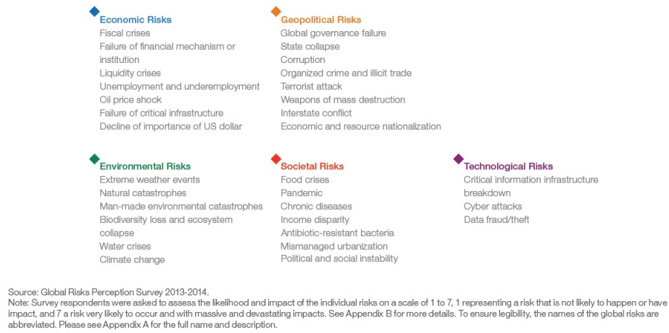
WEF Risk Categories
Economic
Geopolitical
Environmental
Societal
Technological
State collapse
Corruption
Failure of critical infrastructure
Food crises
Income disparity
Mismanaged urbanization
Critical information infrastructure breakdown
Water crises
Climate change

Slide 19
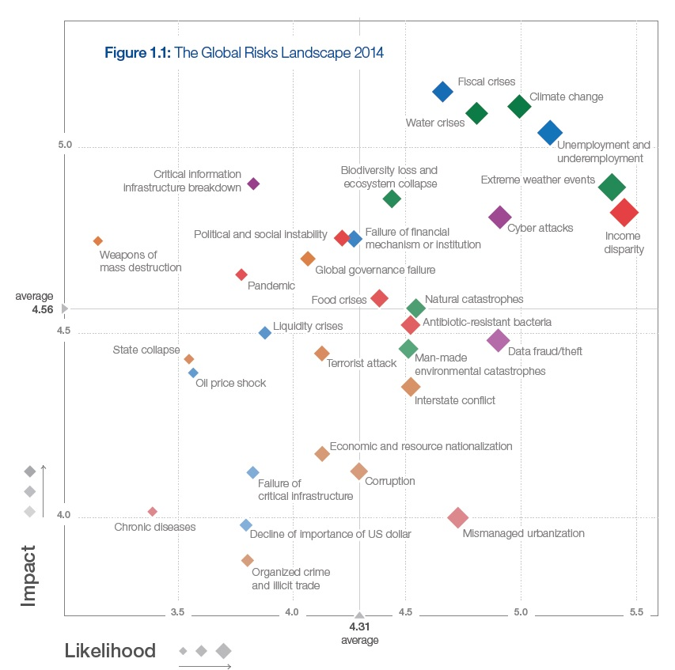
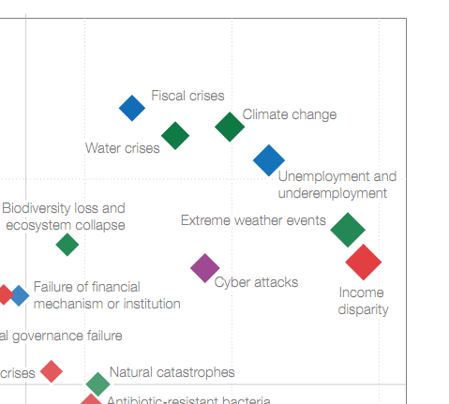
WEF Global Risks Landscape
Economic
Geopolitical
Environmental
Societal
Technological
Seeds of future disasters?

Slide 20
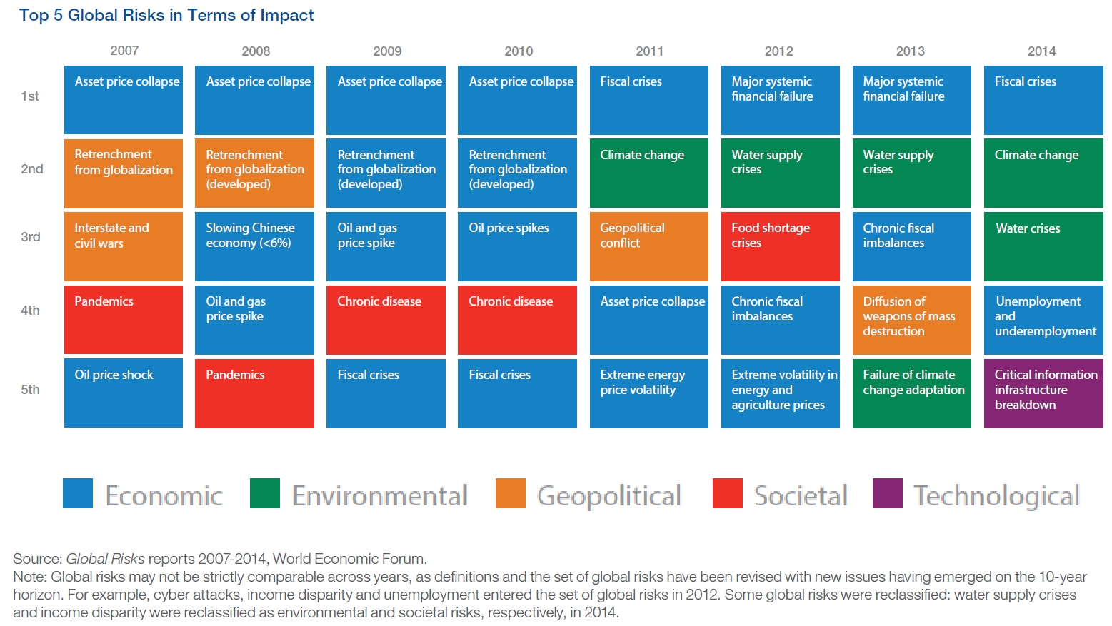
WEF Global Risk Impact (Top 5s)

Slide 21
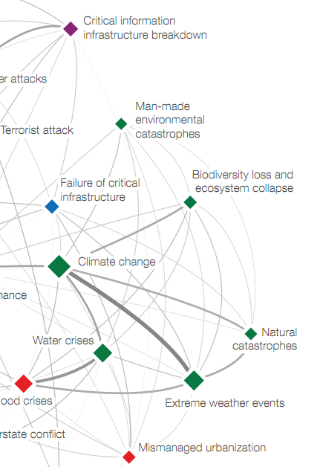
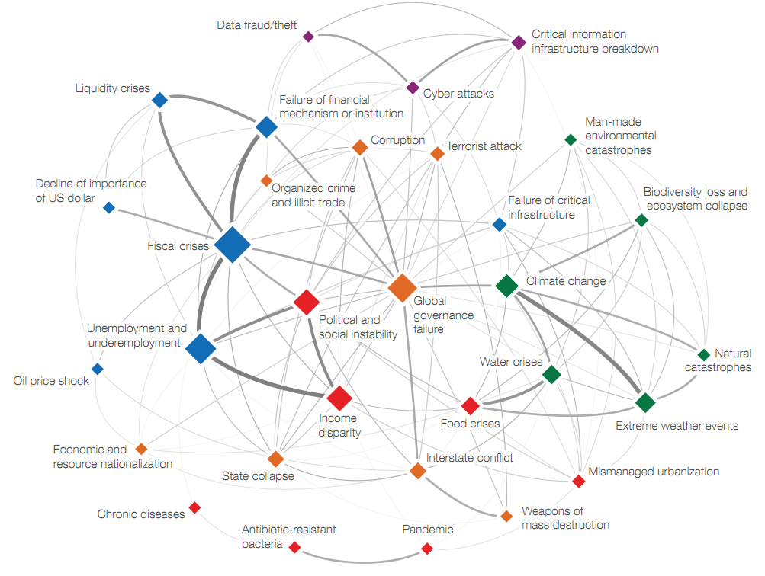
Interconnections Map
Recall, however, the words of Boris Johnson, Mayor of London:
“My friends, as I have discovered myself, there are no disasters, only opportunities. And, indeed, opportunities for fresh disasters.”
Notes:
@ Chris: Plse add animation

Slide 22
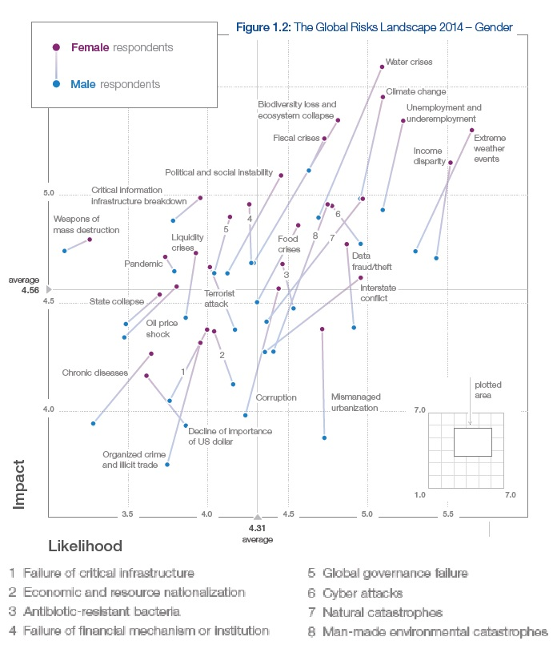
WEF
Global Risks – Gender bias

Slide 23
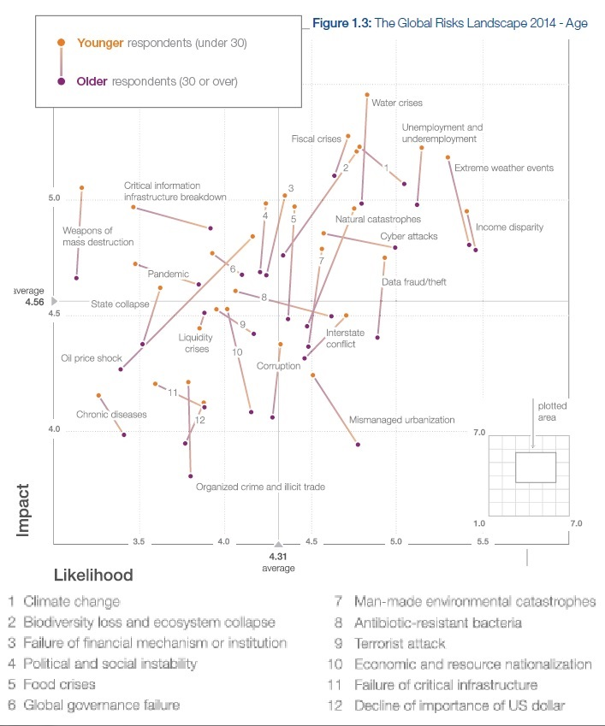
WEF
Global Risks – Age bias

Slide 24
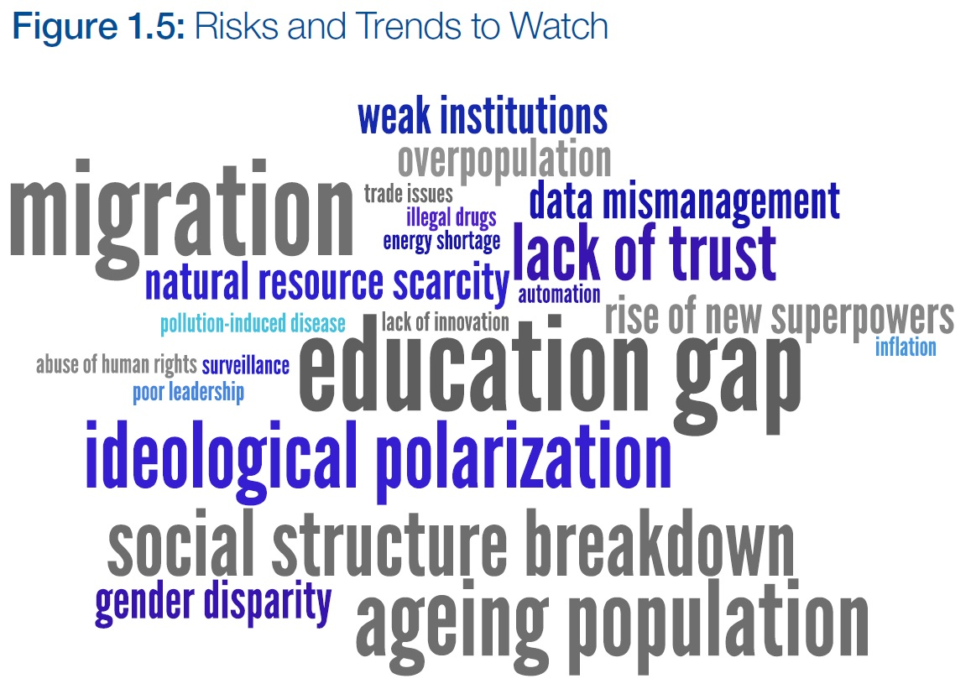
Global Risks and Emerging Trends
Energy shortage
probably more important than currently perceived

Slide 25
Outline
DRR road from Yokohama to Sendai
Perspective on the Sasakawa Prize for DRR
Perceptions on Global Risk: view from Davos (WEF)
UNEP Global Environmental Alert Service (GEAS) viewpoint
Resilience and Sustainability challenges

Slide 26
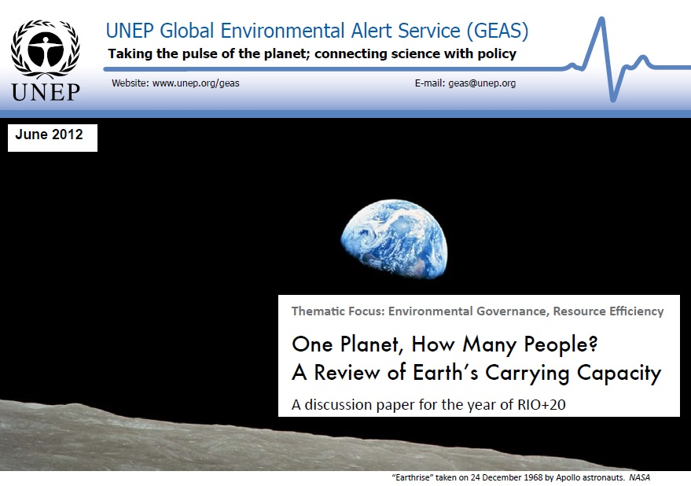
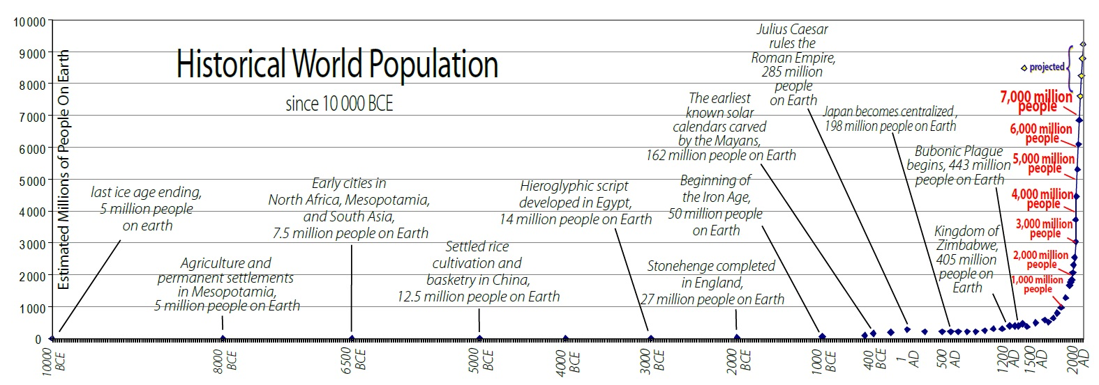
Long-term perspective on vulnerability

Slide 27
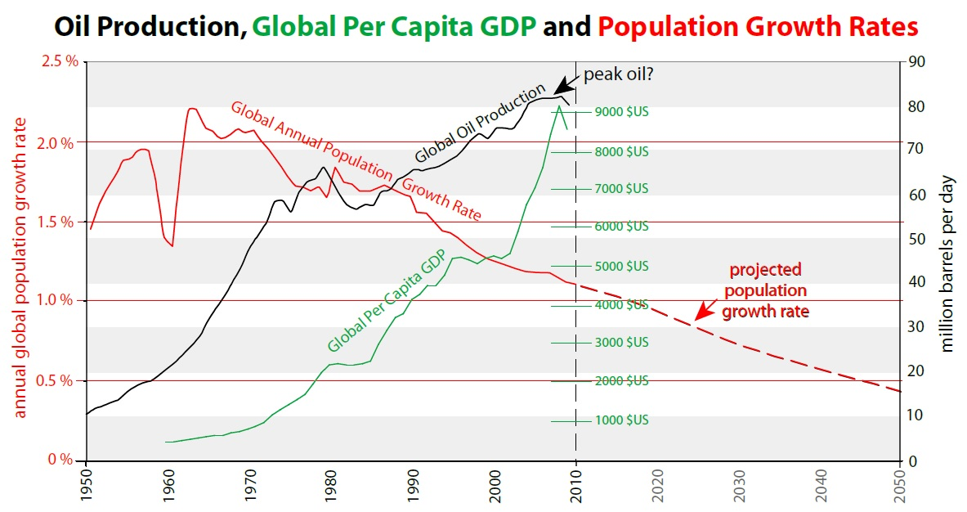
UNEP-GEAS perspective on growth: dependence on fossil-fuel gift?

Slide 28
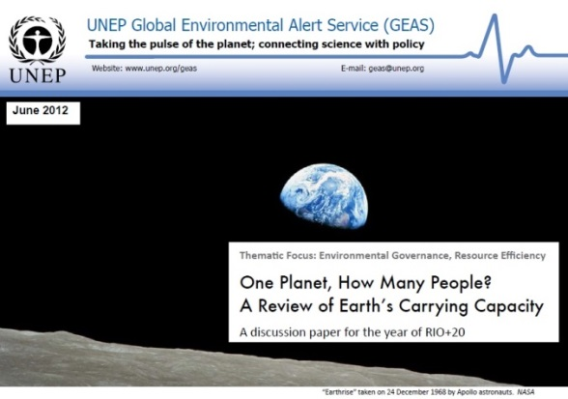
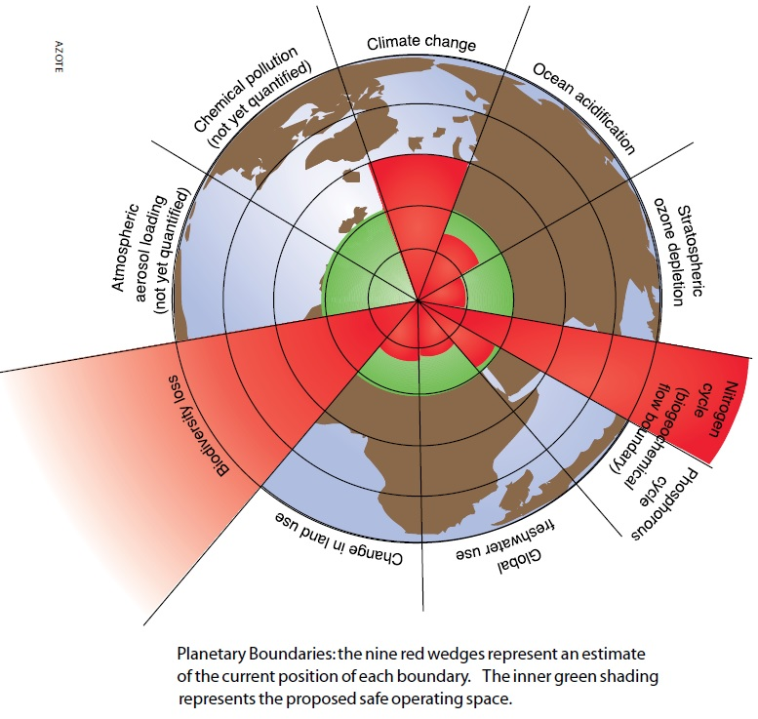
Planetary boundaries framework
seeks to define safe limits for human impact on key Earth System processes that will keep us from crossing the thresholds of tipping points and to help us maintain the overall resilience of the Earth System

Slide 29
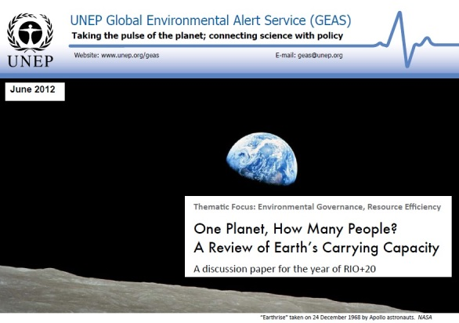
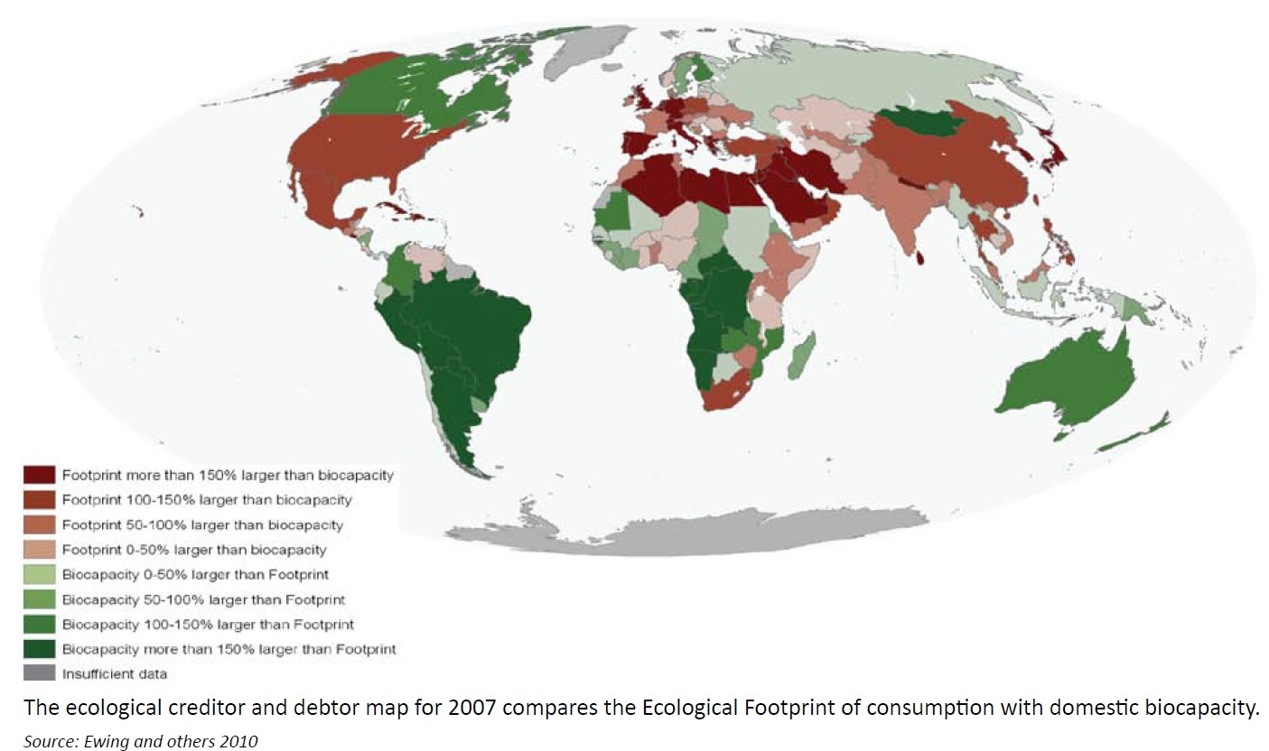
Ecological footprint
a measure of human impact on the planet ... expressed as a budget where resources consumed and waste generated are balanced against nature’s capacity to generate new resources and absorb waste

Slide 30
Five factors in societal collapse
Environmental damage – outstripping of natural resources
Climatic change – failure to adapt or manage impacts
Hostile neighbours – energy diverted to conflict and war
Loss of trading partners – decline of constructive external support
Own responses to environmental problems – role of inhibiting political, social and cultural traditions (values that used to work in different social and environmental context become maladaptive force)
after Jared Diamond (2005)
Collapse: How Societies Choose to Fail or Succeed
Notes:
It is clearly not possible to do justice to the complexity of this problem but I use the summary slide to stimulate debate and to highlight the urgent need to speed up the pace at which we adapt our customs and review strongly held cultural values to accommodate the environmental limitations and challenges posed by Climate Change.
As is emerging in the water sector in South Africa, we are often clinging to values that are no longer appropriate to the changing context
Gender relations are often at the heart of these social and cultural values.
Is the Change we need the Change that others perceive as being the Social Collapse we wish to avoid?
Is it possible that the present global circumstances of climate change and decline in natural resources (including oil) and trade, will, like the two great wars of the last century after which many countries gave women the vote, be a stimulus for escalated change in gender relationships.
If so how do we know how to use it.
From whom can we learn?
What can be done?

Slide 31
Outline
DRR road from Yokohama to Sendai
Perspective on the Sasakawa Prize for DRR
Perceptions on Global Risk: view from Davos (WEF)
UNEP Global Environmental Alert Service (GEAS) viewpoint
Resilience and Sustainability challenges

Slide 32
Resilience: Focus on Cities
“City resilience describes the capacity of cities to function, so that the people living and working in cities – particularly the poor and vulnerable – survive and thrive no matter what stresses or shocks they encounter”.
Jo da Silva, Director,
Arup International Development
Notes:
Source:
http://publications.arup.com/Publications/C/City_Resilience_Framework.aspx
WEF Global Risk Report 2014 (Saved under important readings)
Even as governments and corporations are called upon to speed up greenhouse gas reduction, it is clear that the race is on not only to mitigate climate change but also to adapt. Droughts, super-storms and other natural disasters are increasingly causing systemic risks around the world.
Failure to adapt most strongly affects the most vulnerable, especially those in the least developed countries. They tend to lack the infrastructure and capacity to deal with extreme droughts and floods, reduced crop yields and increased stresses on energy and water supplies.

Slide 33
Resilience: Focus on Water
“Water is a limited, non-substitutable primary resource essential for social well-being, economic development and maintenance of ecosystem services. It is at the core of the three dimensions of sustainable development – social, economic and environmental”
Federal Department of Foreign Affairs (FDFA) / Swiss Agency for Development and Cooperation (SDC)

Slide 34
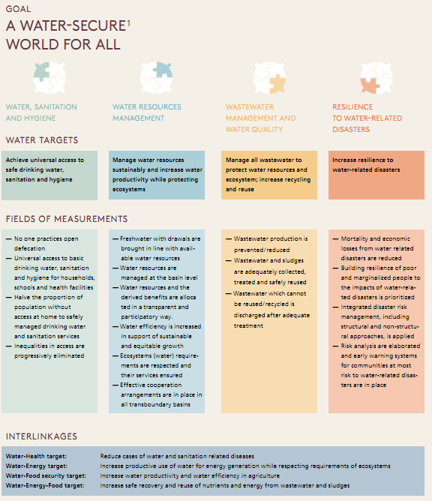
Post-2015 Global goal for water
Achieve universal access to safe drinking water, sanitation and hygiene
Manage water resources sustainably and increase water productivity while protecting ecosystems
Manage all wastewater to protect water resources and ecosystem; increase recycling and reuse
Increase resilience to water-related disasters
Notes:
Source:
A POST-2015 GLOBAL GOAL FOR WATER
Swiss Agency for Development and Cooperation (SDC) in collaboration with IDANE Water

Slide 35
Post-2015 Global goal for water (cont.)
Interlinkages
Water-Health target: Reduce cases of water and sanitation related diseases
Water-Energy target: Increase productive use of water for energy generation while respecting ecosystem requirements
Water-Food Security target: Increase water productivity and water efficiency in agriculture
Water-Energy-Food target: Increase safe recovery and reuse of nutrients and energy from wastewater and sludges

Slide 36
Challenge to good governance
“Contexts for disasters commence before, sometimes a very long time before, the occurrence of the event that triggers what we have misleadingly come to call a ‘natural
disaster’. Corruption is an insidious contributor to that process”
James Lewis, Pat Reid Lecture 2010

Slide 37
Challenge to value systems
“The uncompromising affirmation of core values provides a counter to the seductions of materialism, the lust for power, corruption and greed, which are an inevitable part of all collectives”
Trevor Manuel, in Conversations in Transition (2012)
Notes:
- “The uncompromising affirmation of core values provides a counter
to the seductions of materialism, the lust for power, corruption and greed,
which are an inevitable part of all collectives” (Trevor Manual in Conversations in Transition)

Slide 38
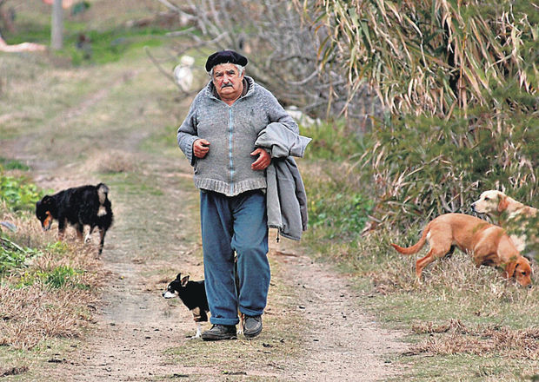
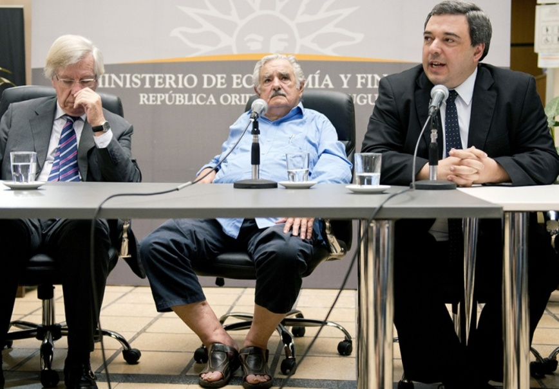
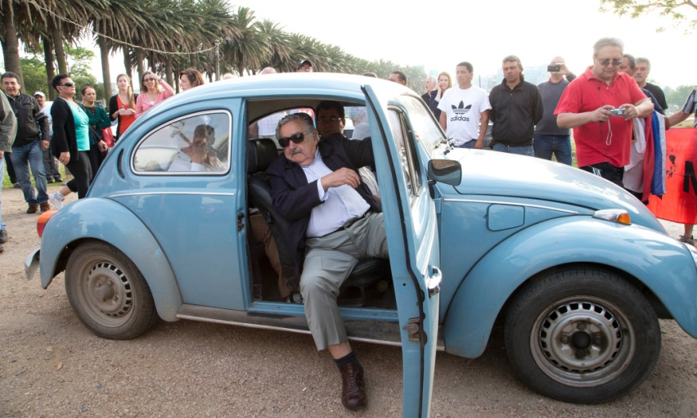
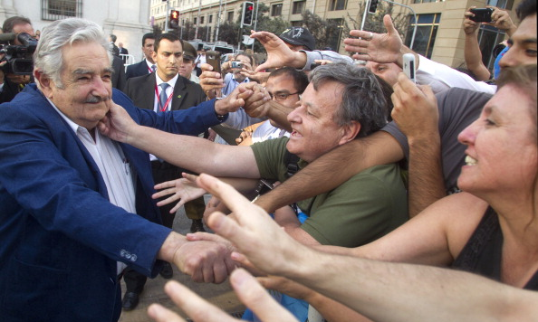
Positive deviance at heart of resilience?
world’s humblest president
“What would happen to this planet if Indians had the same number of cars per family as in Germany?” he asked the audience in Rio. “How much oxygen would be left?”
José Mujica, 40th President of Uruguay (2010- )
Notes:
“What would happen to this planet if Indians had the same number of cars per family as in Germany?” he asked the audience in Rio. “How much oxygen would be left?”
“Since becoming leader of Uruguay in 2010, he has won plaudits worldwide for living within his means, decrying excessive consumption and pushing ahead with policies on same-sex marriage, abortion and cannabis legalisation that have reaffirmed Uruguay as the most socially liberal country in Latin America”.
http://www.theguardian.com/world/2013/dec/13/uruguay-president-jose-mujica

Slide 39
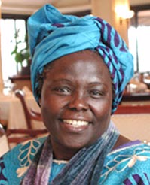
Question of personal inspiration
“For many years I have asked myself, ‘What can I do for the Earth?’ I want to inspire others to ask that question, and answer it wherever and whenever they can. My experience has taught me that individual efforts do matter. However, unless there is political will and public support around the world, the enormous benefits the environment bestows on us will be lost. Future generations will pay the price.”
Wangari Maathai
(1940-2011)
Quoted by President Kgalema Motlanthe,
opening address to 2009 Climate Change Summit in South Africa
Notes:
We can rely on Wangari Maathai to put her finger on the button.
I am currently inclined to think that despite best intentions, the gap between policy and action partly arises from the difference between the local scale at which the impact of Climate change is most keenly felt and the social scale at which a Gender–sensitive approach is being mainstreamed.
The conflict between old and new value systems fall into this gap. And because it often involves deeply held cultural beliefs that may or may not actually be in conflict with national or international legislation we tend to avoid the challenge.
There has been much done to mainstream Gender into DRR but neither DRR nor Gender are yet mainstreamed in all the different sectors.
We need a new way of doing things, one that includes women and men. The challenge of mainstreaming Gender into DRR in my view has only just begun because we are only just beginning to more concretely understand what the challenge is.

Slide 40
Thank you!

